Slide 1
Design & Task-Based Optimization Of A Modular Robot Manipulator Working In A Heavily Constrained Environment
By: Asbjørn Tjensvold
Supervisors: Martin Fodstad Stølen & Daniel Schäle

Slide 2
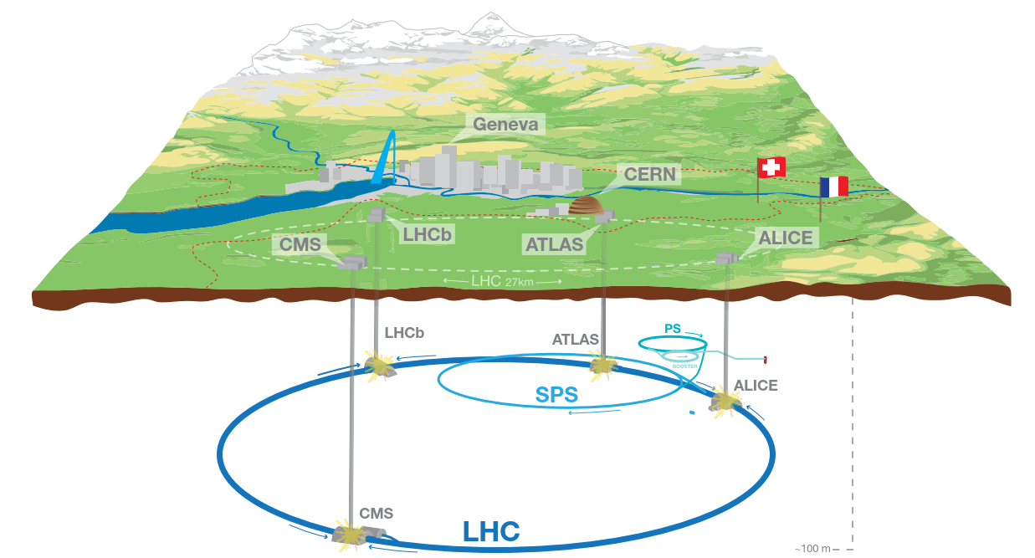
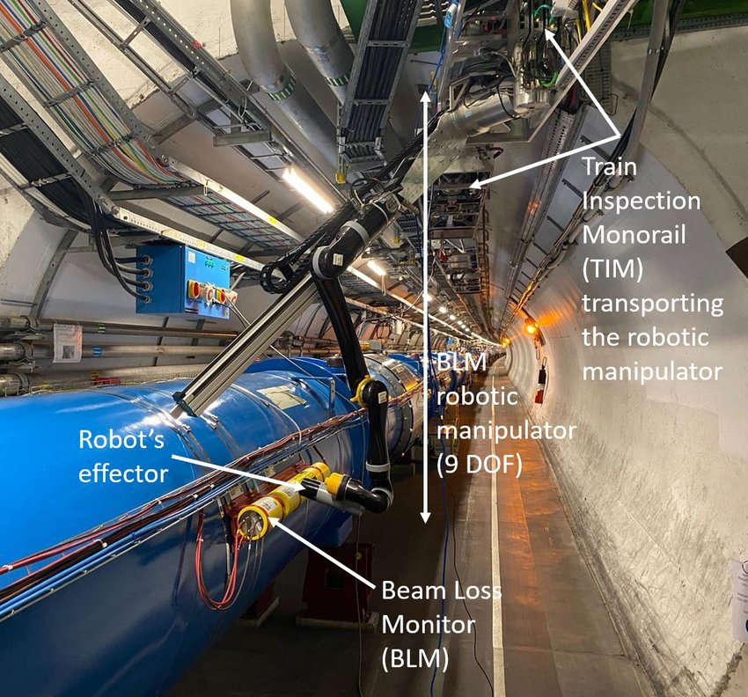
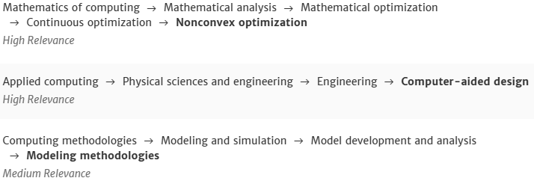
Introduction & Motivation
Research questions:
Is it possible to design a new robotic arm to meet the specific challenges of the LHC tunnel, eliminating the need for external solutions without compromising the efficiency of the TIM system?
Is it possible to create a modular design for this system?
Is it possible to remove degrees of freedom (DOF) from the design and not lose functionality?
How do you adequately measure the performance of a robot arm?
CSS Classification

Slide 3
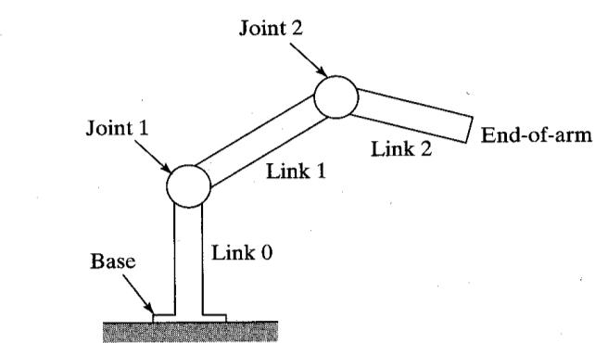
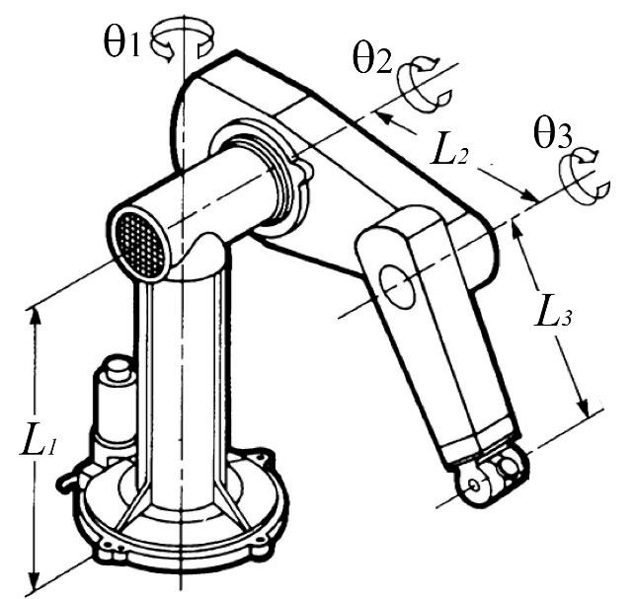
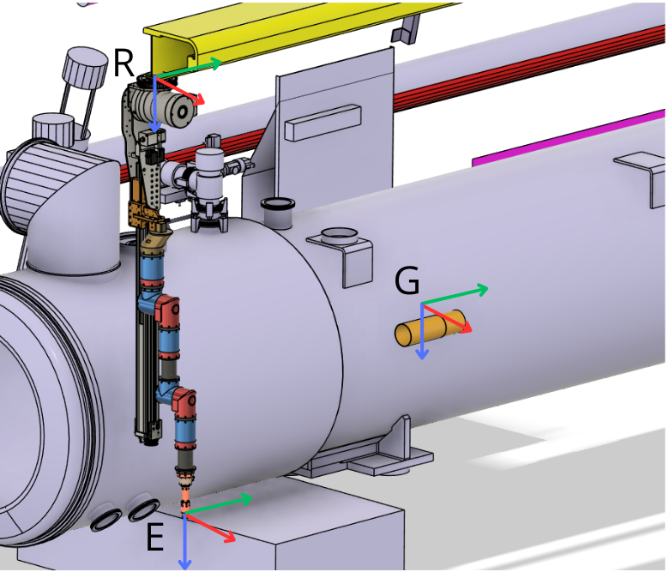
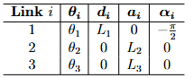
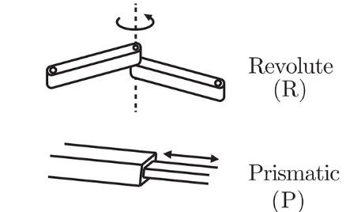
Background
Mechanical design:
Joints & Links
End Effector
Actuator review
Modularity
Mathematical modeling:
Poses
DH Parameters: a, d, α, θ

Slide 4
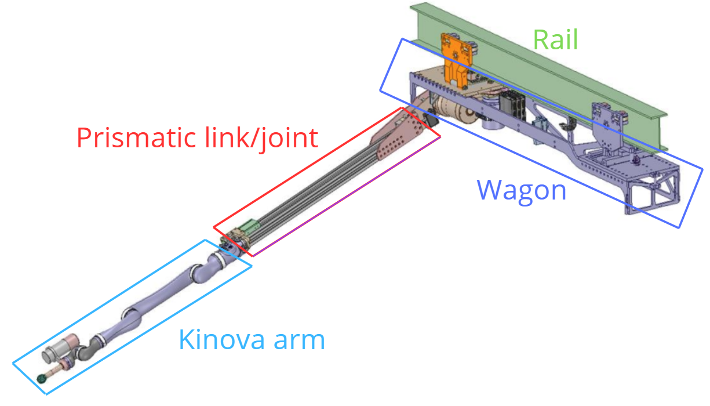
Current vs new solution
Issues with current solution:
Overly complicated
End of life for commercial kinova arm
Not specialized for tasks
Benefits of proposed solution:
Modular & Parametric design: Can easily adapt to changing tasks & environment
Simpler maintenance
Optimized for this specific set of tasks
Similar work:
Lower complexity
Focuses on either optimization or module design

Slide 5
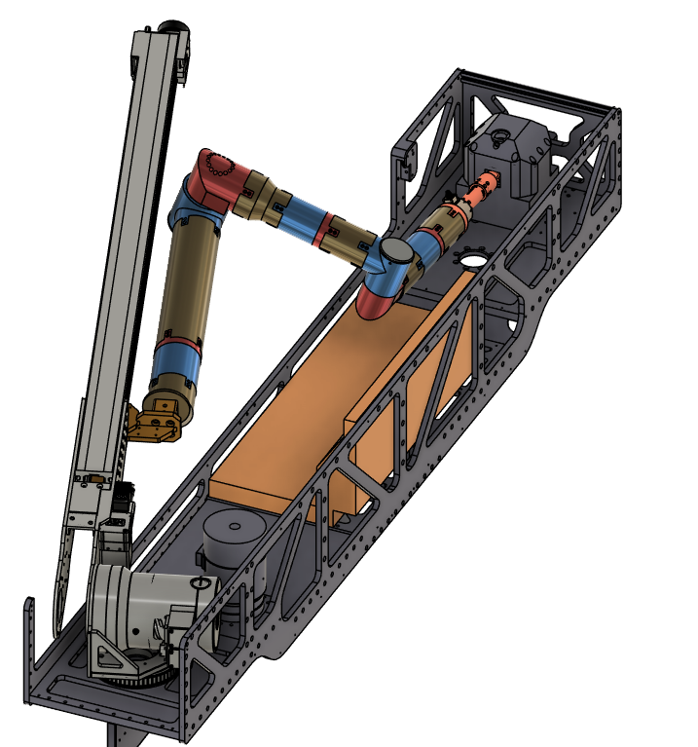
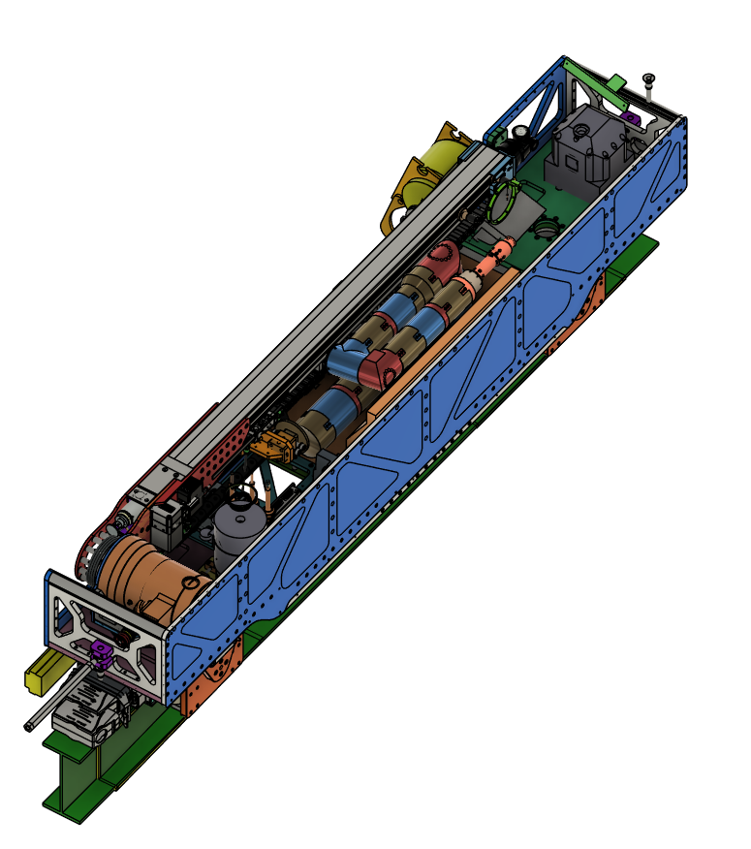
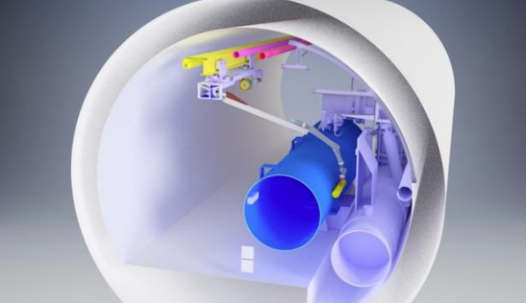
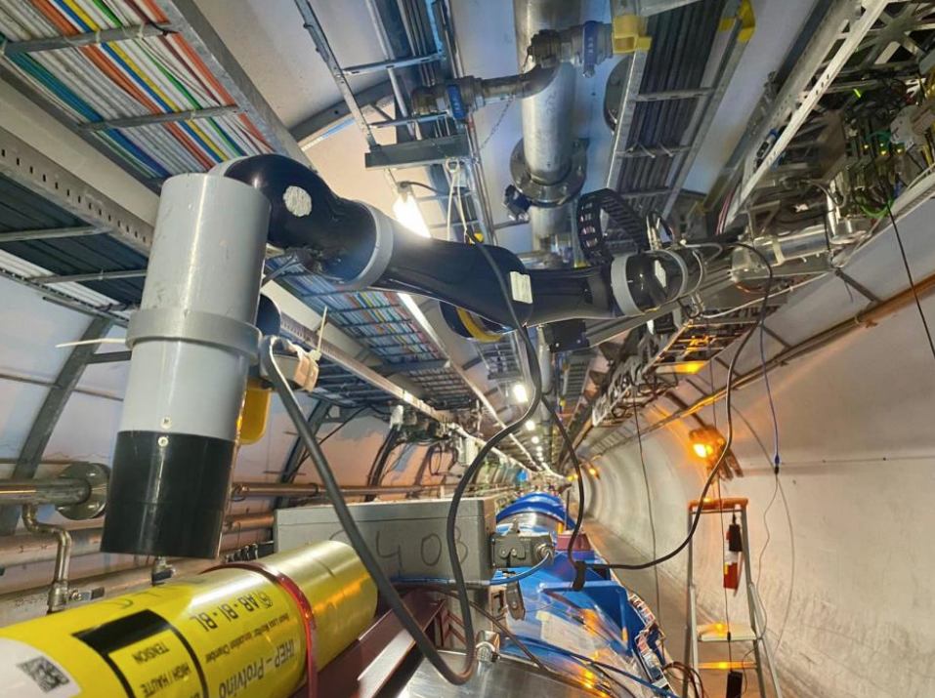
Task Definition
Source Extraction & Folding
Radiation mapping and information gathering

Slide 6
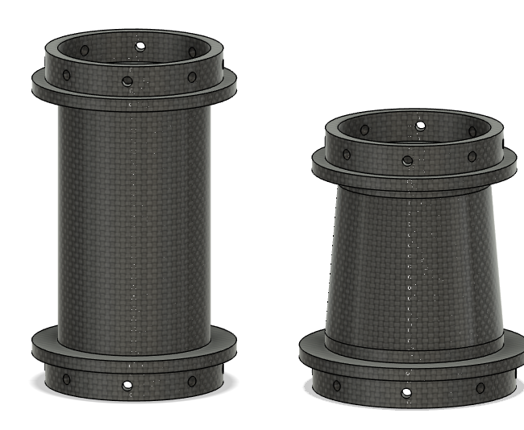
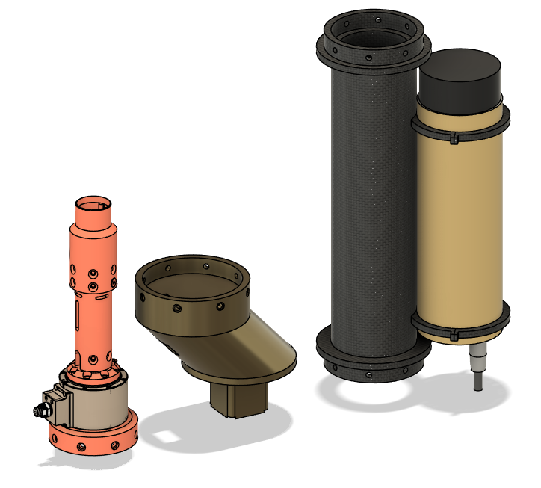
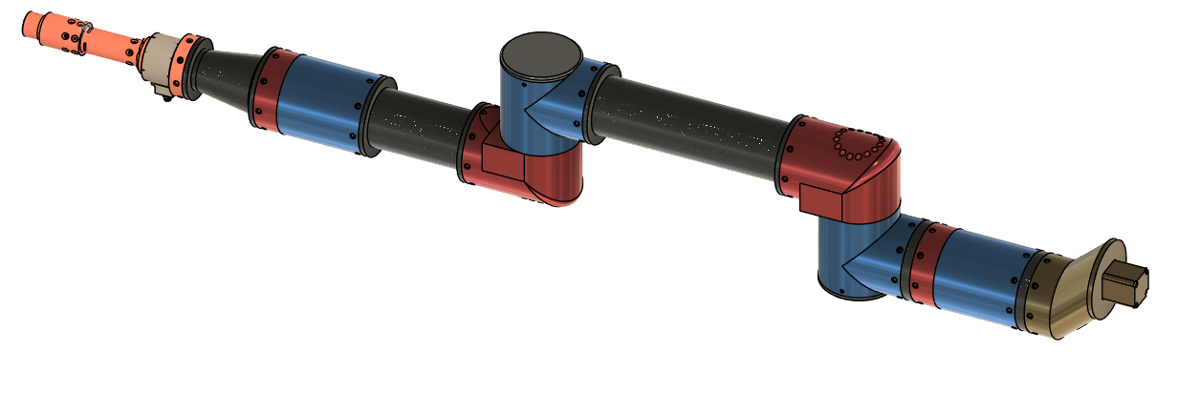
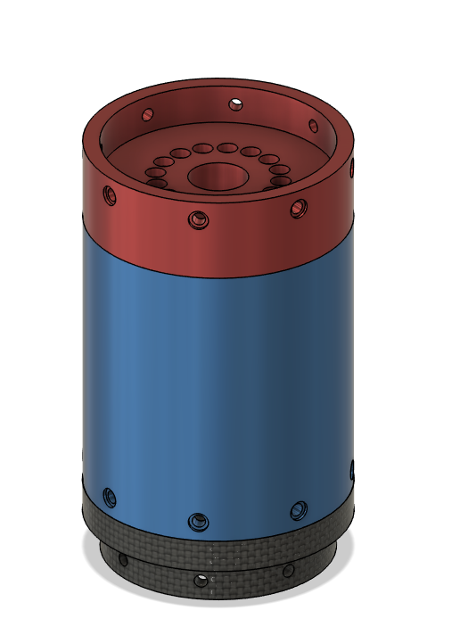
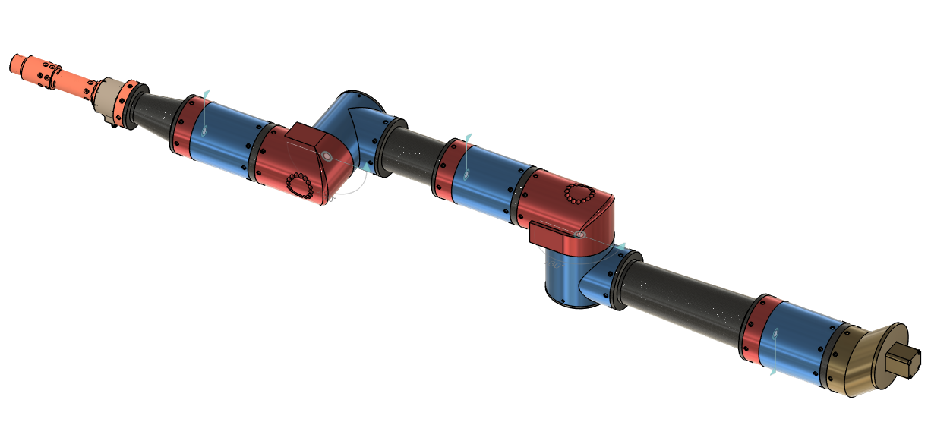
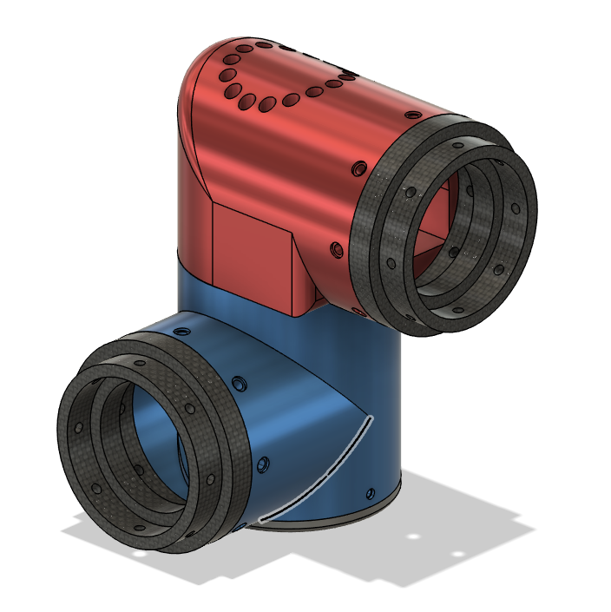
Methodology:Design

Slide 7
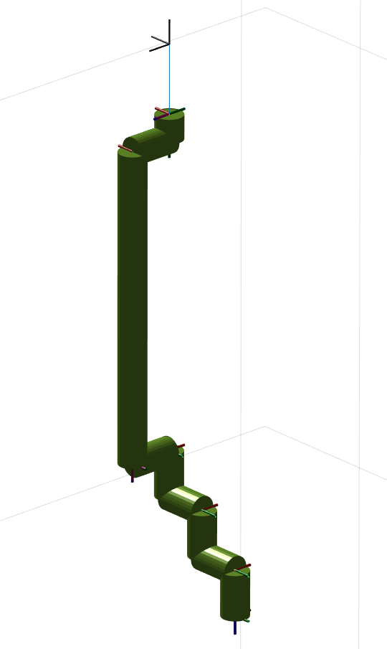
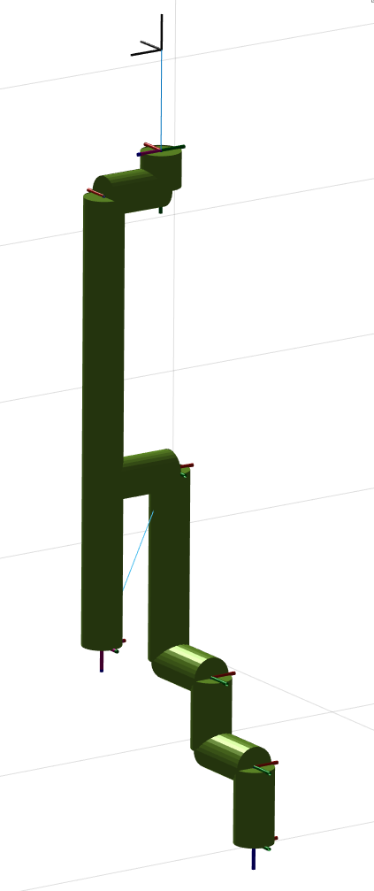
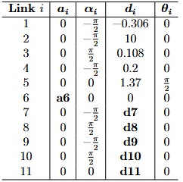
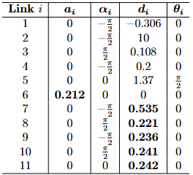
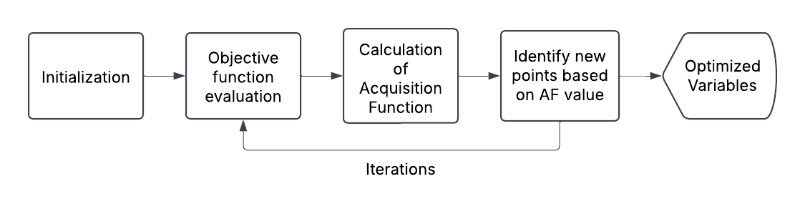
Methodology:Optimization
Perform path planning with collision avoidance
Evaluate performance(reachability)
Minimize total length(a₆ + d₇₋₁₁)

Slide 8
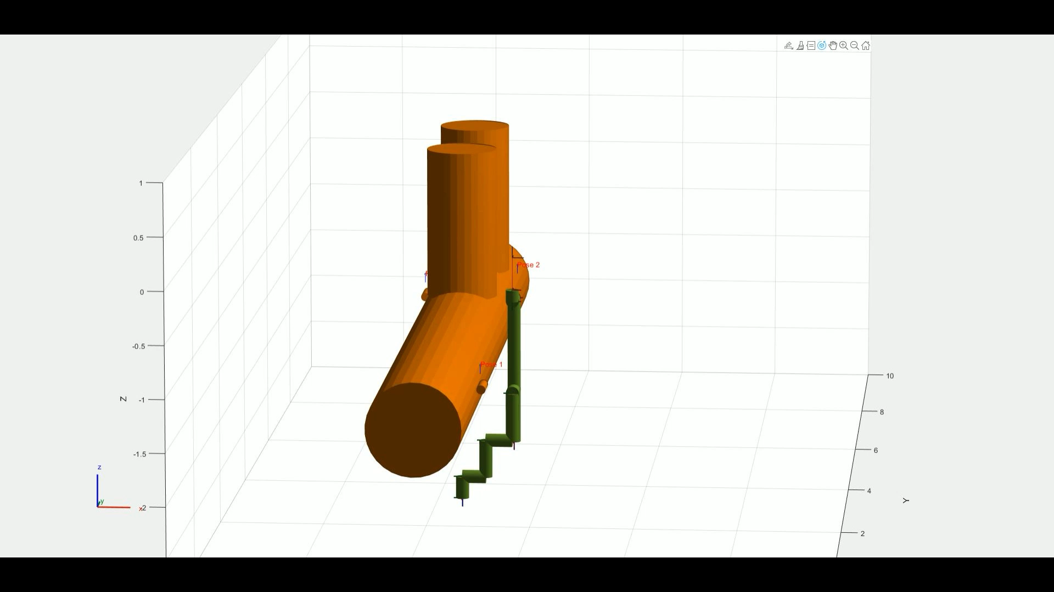
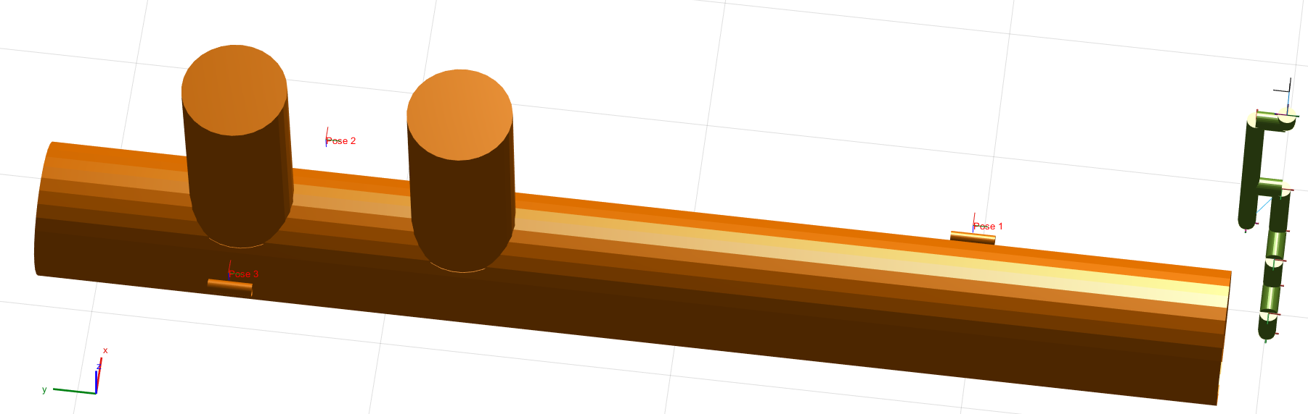
Results

Slide 9
Future Work
Implement final constraint: Foldability
Optimization parameter tuning
Evaluate results for other kinematic structures(4 DOF)
Manufacture & test prototype

Slide 10

Conclusion & Final Thoughts
Is it possible to design a new robotic arm to meet the specific challenges of the LHC tunnel, eliminating the need for external solutions without compromising the efficiency of the TIM system?
Is it possible to create a modular design for this system?
Is it possible to remove degrees of freedom (DOF) from the design and not lose functionality?
How do you adequately measure the performance of a robot arm?
Reachability, collision avoidance, accuracy

